Slide 1














BATCH - 5
DESIGN THINKING AND ENGINEERING ORIENTATION
SUBMITTED TO : Dr KRISHNA CHENNAKESAVA RAO

Slide 2



Batch members
BATCH - 5 ECE II A Sec
241FA05042 | S.GANESH ANIRUDH
241FA05043 | R.THARUN
241FA05053 | A.SANJAY VENKAT
251LA05002 | N.ESHWAR NAGA PAVAN

Slide 3


project title
Dual-Mode Home Automation System(Voice and Manual)
using Node MCU

Slide 4

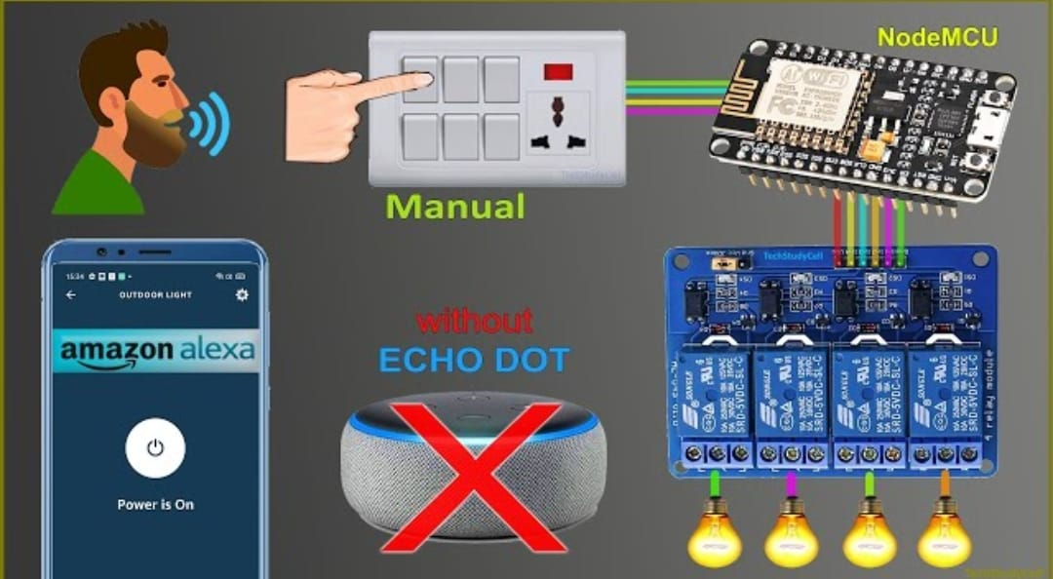

Project overview
This project aims to design and implement a low-cost, flexible, and user-friendly home automation system that allows users to control electrical appliances (like lights, fans, etc.) through two primary modes: Voice Commands and Manual Control

Slide 5

Tools required
Key components required
ESP-12E ESP8266 Node Mcu
4-Channel Relay Module
LEDs / Bulbs (for testing)
Jumper wire
Manual switches
5v adapter
Connecting wires
Laptop/Smart phone
Sinric Pro
Amazon Alexa App
Google Home App

Slide 6
Cost analysis
Equipment | Cost analysis
Node Mcu | ₹400
Relay module | ₹350
Adapter | ₹120
B-type cable | ₹60
Bulbs | ₹80
Bulbs holders | ₹40
Wire | ₹100
4 switches | ₹80
Jumper wires | ₹90
Box | ₹120
Total | ₹ 1440.00

Slide 7
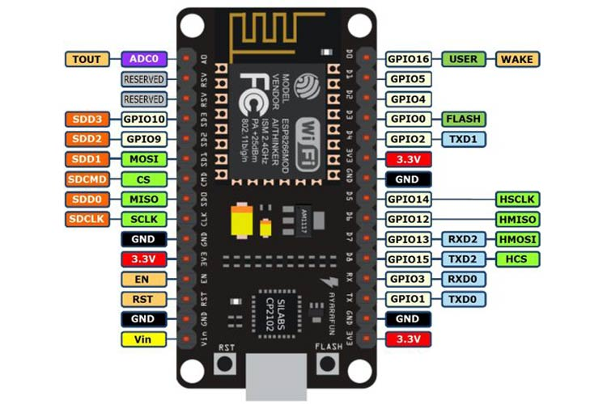
COMPONENTS DETAILS
ESP-12E ESP8266 Node Mcu:
The brain of the system, this Wi-Fi-enabled development board based on the ESP8266 chip runs the firmware, connects to your router, and hosts the local web server. It processes all logic, from reading button inputs and controlling relays to communicating with the Sinric Pro cloud for voice integration, making the entire automation system possible.
Pin Category | Name | Description
Power | Micro-USB, 3.3V, GND, Vin | Micro-USB: NodeMCU can be powered through the USB port 3.3V: Regulated 3.3V can be supplied to this pin to power the board GND: Ground pins Vin: External Power Supply
Control Pins | EN, RST | The pin and the button resets the microcontroller
Analog Pin | A0 | Used to measure analog voltage in the range of 0-3.3V
GPIO Pins | GPIO1 to GPIO16 | NodeMCU has 16 generapurpose input-output pins on its board
SPI Pins | SD1, CMD, SD0, CLK | NodeMCU has four pins available for SPI communication.
UART Pins | TXD0, RXD0, TXD2, RXD2 | NodeMCU has two UART interfaces, UART0 (RXD0 & TXD0) and UART1 (RXD1 & TXD1).
I2C Pins |  | NodeMCU has I2C functionality support but due to the internal functionality of these pins, you have to find which pin is I2C.

Slide 8
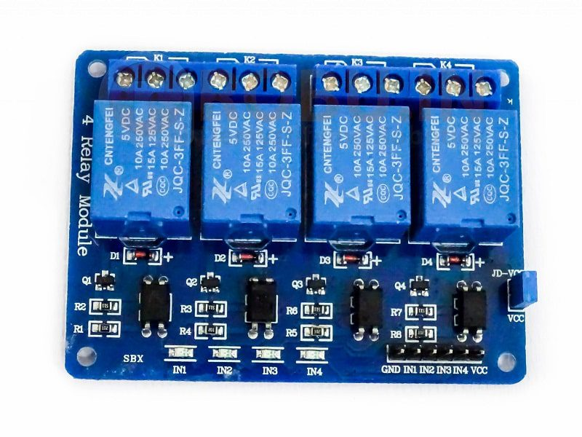
COMPONENTS DETAILS
4-Channel 5V Relay Module
A 4-Channel Relay Module is an electronic device that allows you to control four high-voltage or high-current devices using a low-voltage signal from a microcontroller like Arduino or ESP8266. It's commonly used in home automation, robotics, and industrial control applications.
Key Features:
4 Relay Channels: Can control four devices independently.
2. High-Current Handling: Each relay can handle high currents (typically 10A or more).
3. Low-Voltage Control: Can be controlled using low-voltage signals (3.3V or 5V).
4. Isolation: Provides electrical isolation between the control signal and the relay contacts.

Slide 9
Software applications like sinric pro, amazon alexa
The Arduino IDE is used to write and upload code to the NodeMCU. The ESP8266 core package is installed to add board support for Wi-Fi functionalities. The Sinric Pro cloud platform and its library act as the bridge for voice control. The Amazon Alexa and Google Home apps are used to discover and manage the connected devices. Finally, the Serial Monitor within the IDE is crucial for debugging and monitoring the system's operation.

Slide 10
Hardware Implementation
The circuit is very simple, I have used D1, D2, D5 & D6 GPIO to control the 4- channel relay module.And the GPIO SD3, D3, D7 & RX are connected with manual switches to control the relay module manually.
I have used the INPUT_PULLUP function in Arduino IDE instead of using the pull-up resistors with each switch.As per the source code, when the control pins of the relay module receive the LOW signal the respective relay will turn on and the relay will turn off for the HIGH signal in the control pin.I have used a 5V 2Amp mobile charger to supply the circuit.
**The Boot will fail if SD3 and D3 are grounded during the Boot process. So manual switch-S1 and switch-S2 must be OFF during NodeMCU Boot.
Now, if you want to use pushbuttons then just connect the pushbuttons across the GPIO pins and GND pin instead of switches.

Slide 11
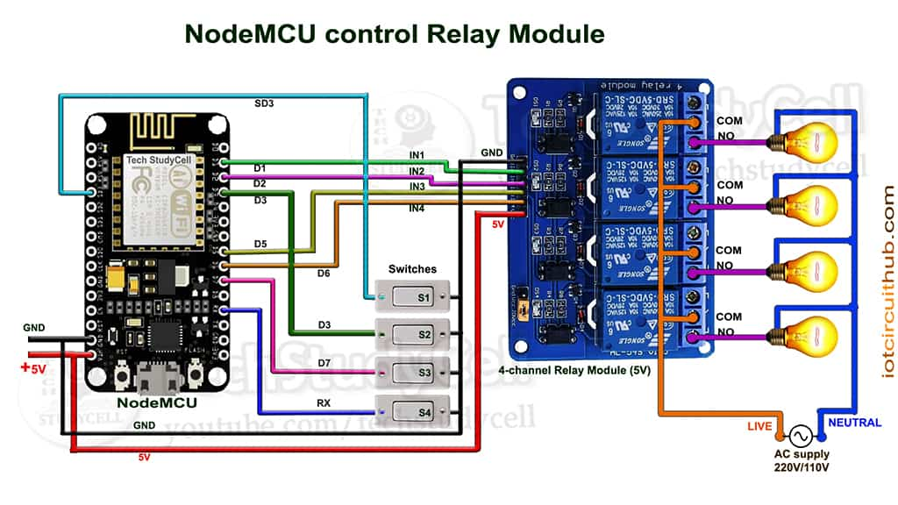
Hardware connections:

Slide 12
Software code for nodemcu:
All the steps to program the NodeMCU using Arduino IDE.
Update the Preferences –> Aditional boards Manager URLs: https://dl.espressif.com/dl/package_esp32_index.json, http://arduino.esp8266.com/stable/package_esp8266com_index.json
Then install the ESP8266 board from the Board manager or Click Here to download the ESP8266 board.
Download the required libraries from the following links: Siniric Pro by Boris Jaeger (Download Sinric Pro examples for ESP8266 & ESP32)
WebSockets by Markus Sattler (minimum Version 2.3.5)
ArduinoJson by Benoit Blanchon (minimum Version 6.12.0)
Click Here to visit the GitHub page of Sinric Pro for more details.
**Please download the latest version of the libraries from the given links. Then install the libraries at Arduino IDE – Sketch – Include Library – Add Zip Library.
https://github.com/nenpece0236-droid/Automation-code.git

Slide 13
Controlling the System with Voice Assistants
Using Amazon Alexa
Setup: Enable the Sinric Pro skill in the Amazon Alexa app and link your account.
2. Voice Commands: Use voice commands like "Alexa, turn on device 1" or "Alexa, turn off device 2" to control your appliances.
Using Google Home
Setup: Link your Sinric Pro account to Google Home and assign devices to rooms.
2. Voice Commands: Use voice commands like "Hey Google, turn on device 1" or "Hey Google, turn off device 2" to control your appliances.
How it Works
The system uses the ESP8266 microcontroller to connect to the internet and communicate with the Sinric Pro server. The Sinric Pro server integrates with Amazon Alexa and Google Home, allowing you to control your devices using voice commands. When you issue a voice command, the server sends a signal to the ESP8266, which then controls the relay module to turn devices on or off.

Slide 14
Applications
Smart home systems (lights, fans, AC, and plugs).
Office or industrial automation.
Energy monitoring and scheduling.
IoT-based security systems.
Voice-controlled home automation with Alexa or Google Assistant (extension).
Advantages:
Wi-Fi based control (no need for Bluetooth range limitations).
Can be accessed via any device connected to the same network.
Compact and low-cost IoT solution.
Easily expandable to more devices or sensors.
Can be integrated with cloud platforms like Blynk, ThingSpeak, or Firebase.

Slide 15
conclusion
The Home Node Automation using ESP8266 successfully demonstrates a simple and efficient system to control household appliances through Wi-Fi. The NodeMCU board, with its built-in Wi-Fi capability, allows remote access and monitoring of connected devices via a smartphone or computer browser. This project highlights the role of IoT and microcontrollers in developing smart, energy-efficient homes and forms the foundation for future automation systems.

Slide 16




THANK YOU

